Slide 1
Velocity

Slide 2
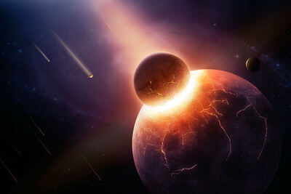
After completing this Smart Lesson you will be able to:
Define the term velocity.
Compare instantaneous and average velocity.

Slide 3
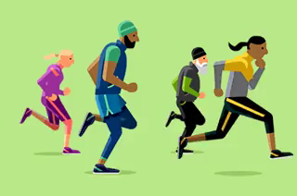
Velocity
Velocity is defined as the rate of change of displacement of an object.
The symbol for velocity is v and the SI unit is m/s.
If the rate of change is measured at an instant in time then this is an instantaneous velocity.
If the rate of change is calculated using the formula velocity = displacement / time , then this is average velocity.

Slide 4
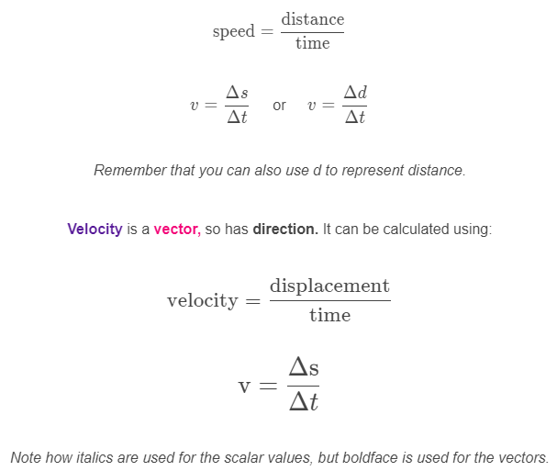
Velocity equation.
You have previously learned that speed can be calculated using:

Slide 5

Just as displacement is made up of distance and direction, velocity is made up of speed and direction of motion.
The speed of an object is how fast the distance to the object is changing over time. Speed is a scalar.
The velocity of an object is how fast the displacement of the object is changing over time. Velocity is a vector.
Both speed and velocity are measured in metres per second (ms⁻¹).

Slide 6
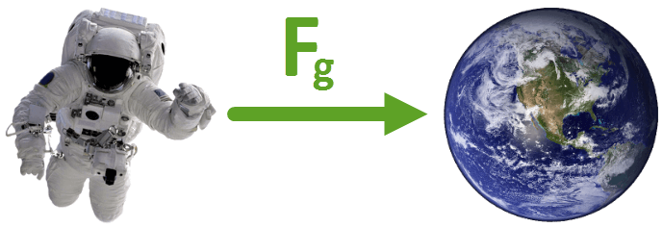
Speed is a scalar, which means it's described by a size only.
Other examples of scalars are distance and mass. None of these quantities have a direction.
Velocity is a vector, which means it's described by a size and direction. Another example of a vector is the force of gravity, as it has a size (9.8 ms⁻²) and direction (toward the centre of the Earth).

Slide 7
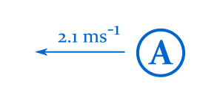
Example
What is the velocity of object A?

Slide 8
Solution
The velocity of object A is 2.1 ms⁻¹ to the left.
You must state both the size and direction of the vector.
We can see that the arrow extending from object A is pointing to the left, and that the label reads 2.1 ms⁻¹. This means that object A is travelling at 2.1 ms⁻¹ to the left.

Slide 9
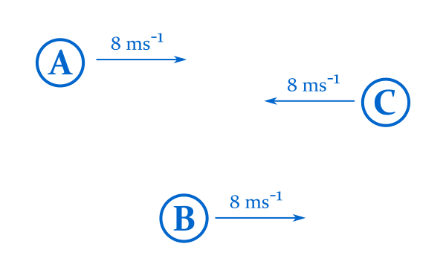
Speed vs. velocity.
Here objects A, B and C all have the same speed (8 ms⁻¹).
A and B have the same velocity (8 ms⁻¹ to the right) as they're travelling at the same speed, in the same direction.
The velocity of C is different (8 ms⁻¹ to the left) as it's travelling in a different direction.

Slide 10
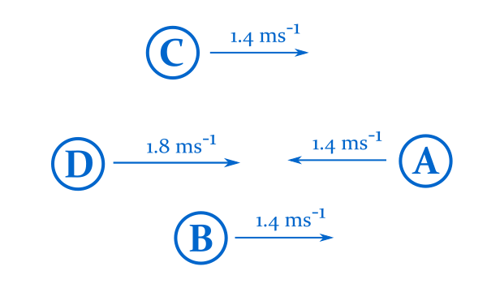
Example
Which two objects are travelling at the same velocity?

Slide 11
Solution
Objects B and C have the same velocity, 1.4 ms⁻¹ to the right.
A is travelling at the same speed, but in a different direction.
D is travelling in the same direction, but at a different speed.

